Slide 1


DA623 : Computing With Signals - Project
Multimodal Analysis and Classification of Environmental Audio Using Spectrogram Representations
This project focuses on classifying environmental sounds by leveraging machine learning techniques. Spectrogram representations are utilized to analyze diverse urban soundscapes. The data source is the UrbanSound8K dataset, comprising 8,732 labeled short sound excerpts from various urban environments. Our goal is to achieve high accuracy in recognizing environmental audio events, with practical applications in urban planning, noise control, and smart city technologies.
by Swapn Agarwal
Roll No.: 210102130

Slide 2

Introduction to Environmental Audio Classification
Importance
Challenges
Environmental audio classification benefits urban planning, noise pollution monitoring, and the development of smart cities by providing automated sound recognition.
It is difficult due to variability in soundscapes, overlapping sounds, and pervasive background noise that complicate accurate detection.

Slide 3
Problem Approach
The classification of environmental audio is approached by leveraging spectrogram representations as input features for convolutional neural networks (CNNs). This technique allows the model to capture both temporal and spectral information essential to differentiating diverse urban sound sources.

Slide 4
Understanding Audio as Data
Audio signals are continuous waves that represent variations in air pressure over time. To process these sounds using computers, they must be converted into a digital format through sampling and quantization, resulting in numerical data arrays called waveforms.
By treating audio as data, we leverage mathematical and computational tools to extract meaningful features that enable automatic recognition and classification of diverse sound events in urban environments.
Key audio characteristics:
Amplitude: Sound intensity/loudness
Frequency: Pitch perception (measured in Hz)
Timbre: Quality that distinguishes different sound sources
Duration: Temporal aspects of sounds

Slide 5
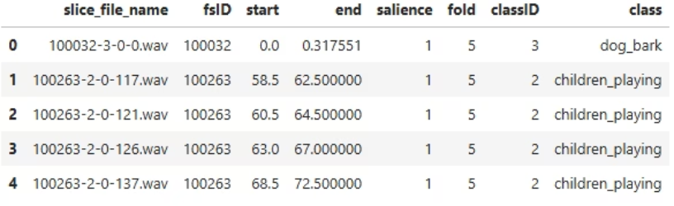
Dataset : UrbanSound8K
Dataset Details
The UrbanSound8K dataset consists of 8,732 labeled audio excerpts covering 10 distinct urban sound categories, such as sirens, car horns, jackhammers, and children playing.
The diverse range of audio categories in the dataset allows for robust training and evaluation of sound recognition systems.
Classes:
Air conditioner
Car horn
Children playing
Dog bark
Drilling
Engine idling
Gun shot
Jackhammer
Siren
Street music

Slide 6
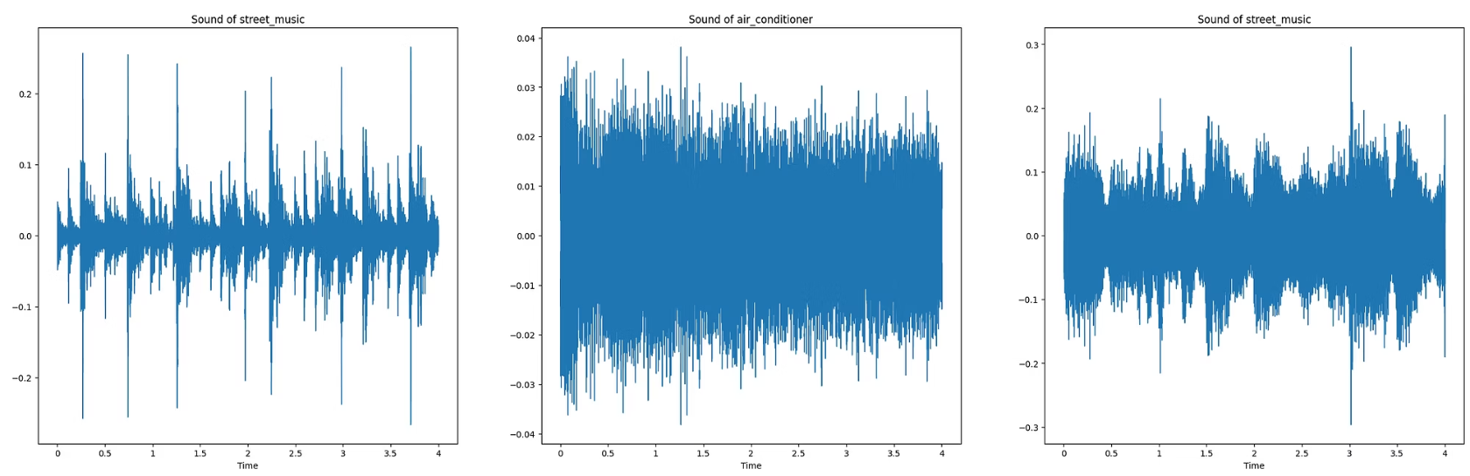
Audio Waveform Examples
Audio samples are visualized using Waveform plots (librosa.display.waveshow) to represent time-domain signal variation. Class distribution is visualized via a bar chart (value_counts().plot()) to understand data imbalance across categories.

Slide 7
From Sound to Vision
To better analyze environmental sounds, audio signals are transformed into visual representations called spectrograms. Spectrograms display frequency content over time, making it easier for machine learning models to identify distinct sound patterns.

Slide 8
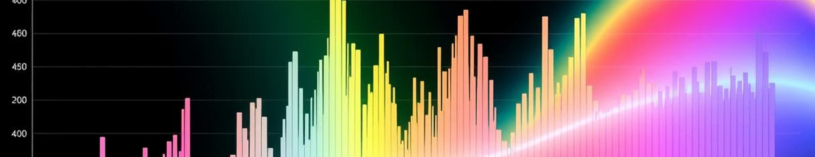
Feature Extraction: Spectrogram Representations
Spectrogram Explained
A visual representation showing how audio signal frequencies vary over time, crucial for understanding sound patterns.

Slide 9
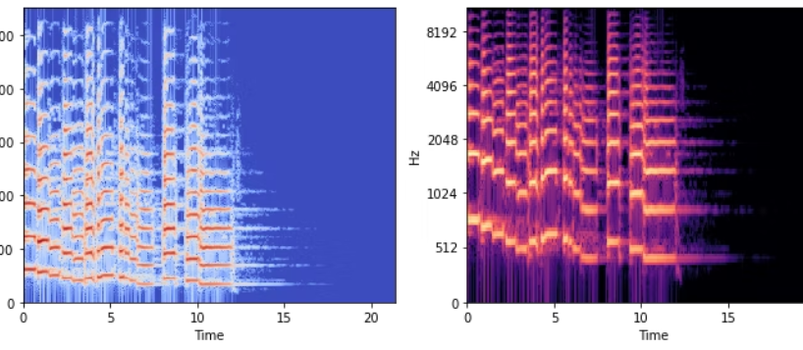
Types of Spectrograms
Two main types of spectrograms are commonly used in audio analysis:
Standard Spectrogram: Displays the intensity of frequencies over time using a linear frequency scale, allowing detailed observation of frequency components.
Mel Spectrogram: Uses a mel scale that approximates human auditory perception, emphasizing frequencies that are more relevant to how we hear sounds.

Slide 10
Why Mel Spectrogram and Mel Scale?
The Mel scale is designed to mimic human auditory perception, prioritizing frequencies that our ears are more sensitive to. By using the Mel scale, Mel spectrograms emphasize these perceptually important frequency bands, making them more effective for audio analysis tasks such as speech and environmental sound recognition.
Mel Spectrograms transform audio signals into a visual format that aligns better with how humans hear, capturing relevant features while reducing less important details. This results in improved accuracy and performance in machine learning models that process audio data.

Slide 11
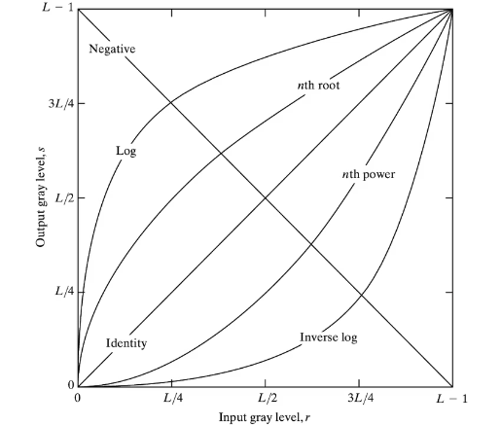
Spectrogram Generation and Image Transformation for Model Input
To enable training deep learning models on audio data, raw audio signals are first converted into spectrogram images — specifically Mel-spectrograms, which closely resemble the way humans perceive sound.
librosa.feature.melspectrogram()
librosa.power_to_db()
librosa.display.specshow()
matplotlib.pyplot
Image Transformation for Model Compatibility:
Once spectrograms are saved, they are transformed to be compatible with neural networks.
Grayscale
Resize
Tensor Conversion
Normalization

Slide 12
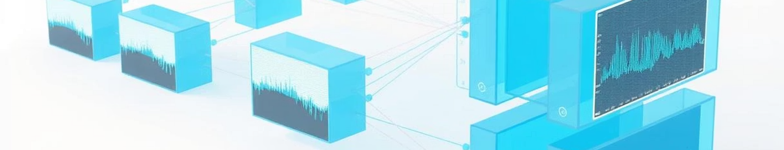


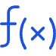
Model Architecture: Convolutional Neural Networks (CNNs)
Convolutional Layers
Regularization
Activation and Loss
Extract hierarchical patterns from spectrograms, identifying local and global audio features.
Techniques like dropout and batch normalization prevent overfitting, ensuring the model generalizes well.
ReLU activation introduces non-linearity. Categorical cross-entropy guides the model to correctly classify audio classes.

Slide 13
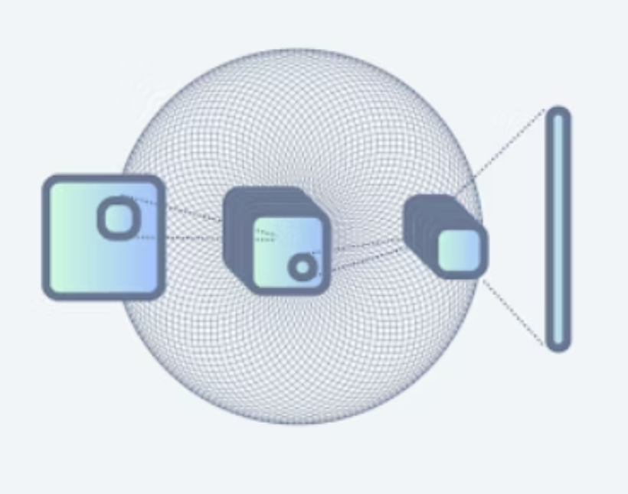
Model Structure Overview:
Input: 128×128 grayscale spectrogram
Layer 1: Conv2d(1→16) → ReLU → MaxPool(2x2)
Layer 2: Conv2d(16→32) → ReLU → MaxPool(2x2)
Layer 3: Conv2d(32→64) → ReLU → MaxPool(2x2)
Flatten: 64 × 16 × 16 = 16384 features
Dense Layer: Linear(16384→128) + Dropout(0.3)
Output Layer: Linear(128→num_classes)

Slide 14
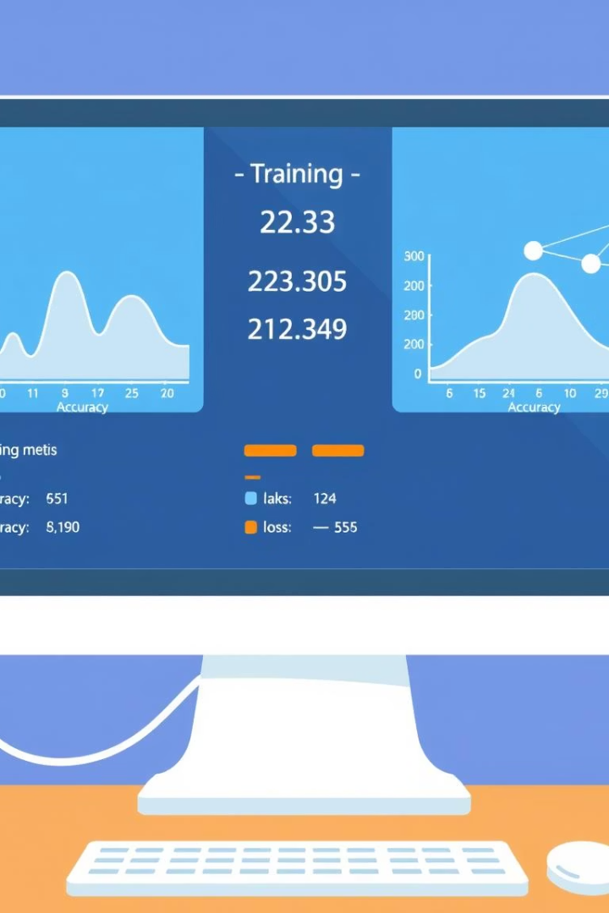
Dataset Split and Training Setup
The dataset is divided into training, validation, and test sets to ensure model generalization and reliable performance evaluation.
Splits include 70% for training, 15% for validation, and 15% for testing.
The training setup involves feeding spectrogram images into the CNN model, optimizing using techniques such as dropout for regularization and ReLU activation functions.

Slide 15
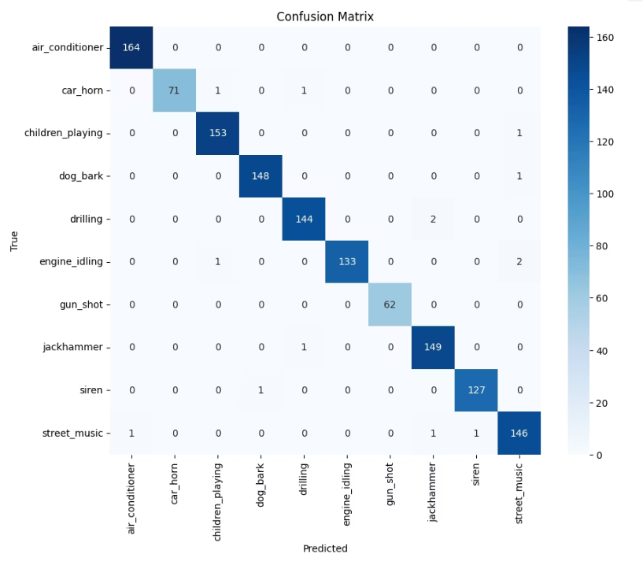
Performance analysis:
Test accuracy:
~97-98% (consistent with validation)
Confusion matrix reveals:
Strong diagonal (correct classifications)
Some confusion between mechanically similar sounds

Slide 16
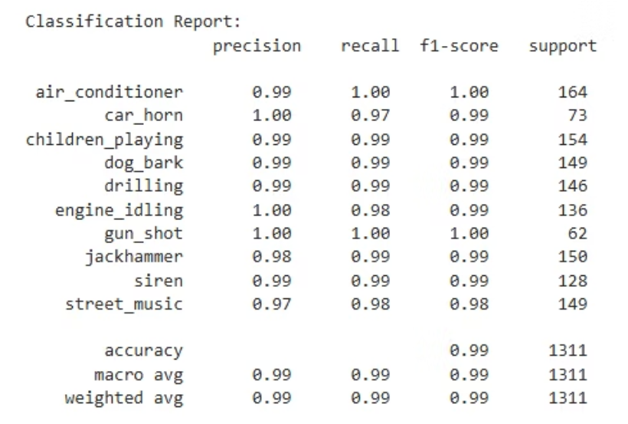
Class-wise Performance
This table summarizes the classification accuracy for each audio class in the test dataset
Observations:
Distinctive sounds (car horn, gun shot) perform best
Ambiguous sounds (street music) more challenging
Performance correlates with spectrogram visual distinctiveness
Per-class metrics:
Precision: Accuracy of positive predictions
Recall: Ability to find all positive instances
F1-score: Harmonic mean of precision and recall

Slide 17

Key takeaways
Spectrogram conversion effectively bridges audio and visual domains
Mel spectrograms outperform raw waveforms and regular spectrograms aligning with human perception (mel scale) improves model performance
Balance between information preservation and dimensionality reduction
Future Directions
Multi-modal fusion: Combine spectrograms with raw waveform features
Attention mechanisms: Focus on time-frequency regions of interest
Self-supervised learning: Leverage unlabeled audio data

Slide 18
Thank You!

